Slide 1
Activation Function, Optimizers and Loss Functions

Slide 2
Activation Functions
1) An activation function is a function that is added into an artificial neural network in order to help the network learn complex patterns in the data.
2) Activation function also helps to normalize the output of any input in the range between
1 to -1 or 0 to 1.
3) The activation function is at the end deciding what is to be fired(activated) to the next neuron.

Slide 3
Properties of Activation Function
Non-Linear
Differentiable

Slide 4
Types of Activation Function
1) Linear
2) Sigmoid
3) Tanh
4) Relu
5) Leaky Relu
6) ELU
7) Softmax

Slide 5
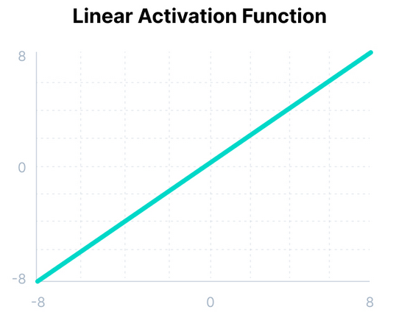

Linear Activation Function
1) Range –infinity to +infinity
2) It has constant derivative, so gradient has no relation with input
3) Used in ANNs for Regression.

Slide 6
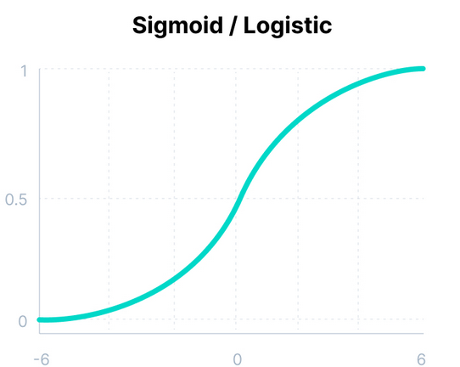
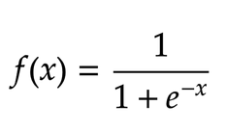
Sigmoid Activation Function
1) Range 0 to 1
2) Used for binary classification models.
3) It suffers from Vanishing Gradient

Slide 7
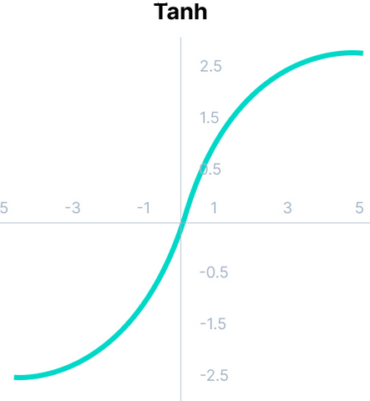
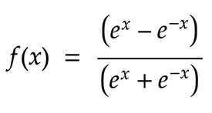
Tanh Activation Function
1) Range –1 to 1
2) Used in RNNs.
3) It suffers from Vanishing Gradient
4) It is zero centered

Slide 8
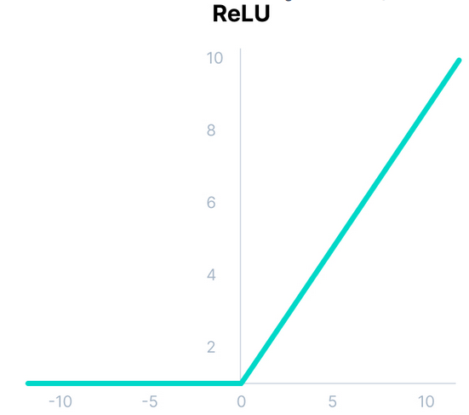

RELU Activation Function
1) RELU stands for Rectified Linear Unit
2) Range 0 to +infinity
3) Used in hidden layers
4) It suffers from Dying Relu problem

Slide 9
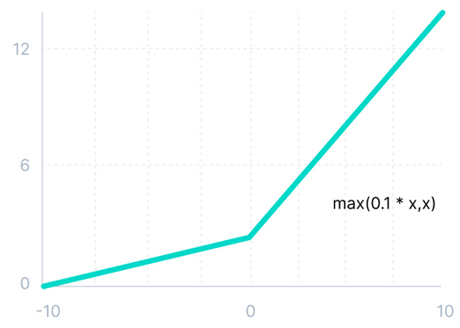

Leaky RELU Activation Function
1) Leaky RELU is another variant of RELU
2) Used in hidden layers
3) It overcomes the Dying Relu problem
Leaky Relu

Slide 10
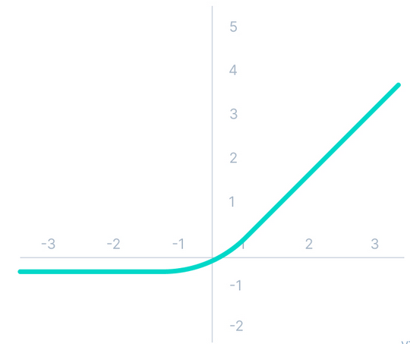
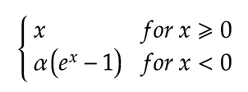
Elu Activation Function
1) ELU stands for Exponential Linear Unit
2) Used in hidden layers
3) It overcomes the Dying Relu problem
4) Suffers from Exploding Gradient
ELU

Slide 11
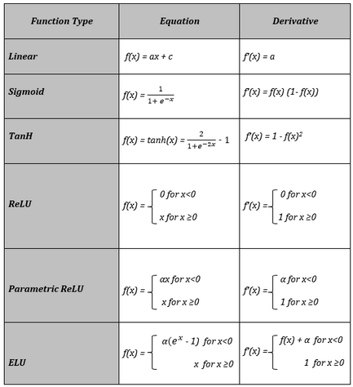
Derivative of common Activation Functions

Slide 12
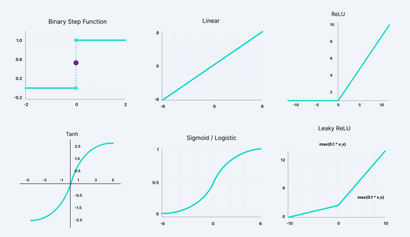
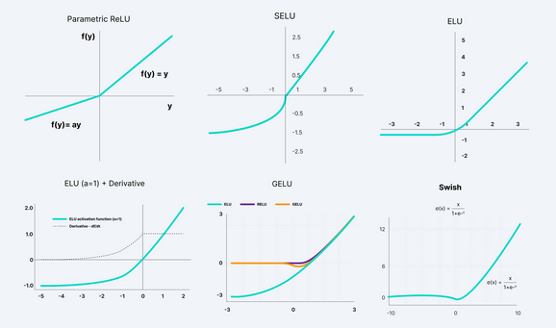
Graph of Common Activation Functions

Slide 13
Vanishing Gradient
1) Like the sigmoid function, certain activation functions squish an ample input space into a small output space between 0 and 1.
2) Therefore, a large change in the input of the sigmoid function will cause a small change in the output. Hence, the derivative becomes small. For shallow networks with only a few layers that use these activations, this isn’t a big problem.
3) However, when more layers are used, it can cause the gradient to be too small for training to work effectively.

Slide 14
Exploding Gradient
1) Exploding gradients are problems where significant error gradients accumulate and result in very large updates to neural network model weights during training.
2) An unstable network can result when there are exploding gradients, and the learning cannot be completed.
3) The values of the weights can also become so large as to overflow and result in something called NaN values.

Slide 15
Optimizers
1) It is very important to tweak/change the weights of the model during the training process, to make our predictions as correct and optimized as possible. This is where optimizers come into picture.
2) They tie together the loss function and model parameters by updating the model in response to the output of the loss function.
3) Optimizers shape and mold your model into its most accurate possible form by maneuvering with the weights. The loss function is the guide to the terrain, telling the optimizer when it’s moving in the right or wrong direction.

Slide 16
Types of Optimizers Function
1) Gradient Descent
2) Stochastic Gradient Descent
3) Mini-batch Gradient Descent
4) SGD with Momentum
5) RmsProp
6) Adadelta
7) Adagrad
8) Adam

Slide 17
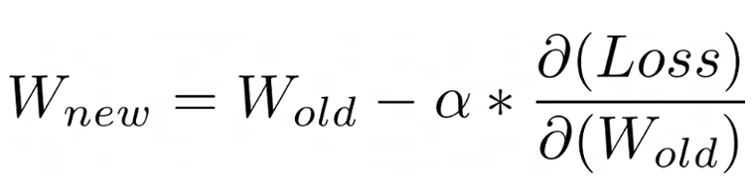
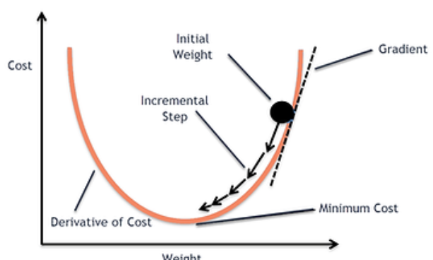
Gradient Descent
1) It minimizes the given function to its local minimum.
2) Gradient Descent iteratively reduces a loss function by moving in the direction opposite to that of steepest ascent.
Drawbacks
a) Slow in computation
b) Requires large memory
c) Computationally Expensive

Slide 18
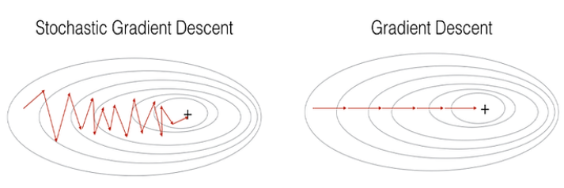
Stochastic Gradient Descent (SGD)
1) In the SGD algorithm derivative is computed taking one point at a time.
2) Memory requirement is less than that of GD
Drawbacks
a) Takes a long time to converge
b) May stuck at local minima

Slide 19
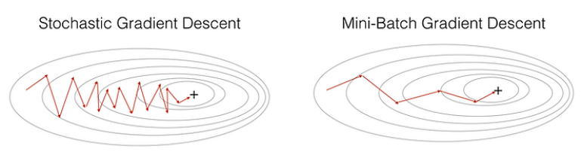
Mini-Batch Gradient Descent
1) MB-SGD algorithm takes a batch of points or subset of points from the dataset to compute derivate.
2) MB-SGD divides the dataset into various batches and after every batch, the parameters are updated.
3) Less time complexity as compared to SGD and more stability.
Drawbacks
a) May stuck at local minima
b) Updated weights may be too
noisy

Slide 20
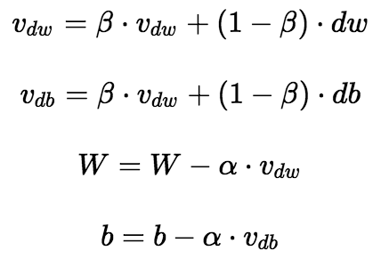
SGD with Momentum
1) MB-SGD algorithm takes a batch of points or subset of points from the dataset to compute derivate.
2) MB-SGD divides the dataset into various batches and after every batch, the parameters are updated.
3) The idea is to denoise derivative using exponential weighting average that is to give more weightage to recent updates compared to the previous update.

Slide 21
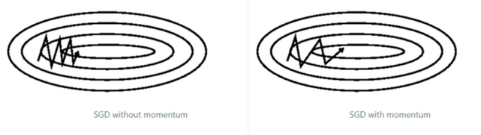
4) The problem with SGD is that while it tries to reach minima because of the high oscillation we can’t increase the learning rate. So it takes time to converge
Drawbacks
a) May stuck at local minima
b) Updated weights may be too
noisy

Slide 22
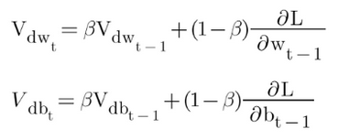
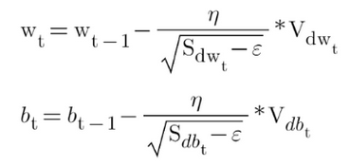
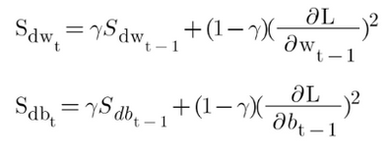
Adam (Adaptive Moment Estimation)
1) It is a method that computes adaptive learning rates for each parameter. It stores both the decaying average of the past gradients , similar to momentum and also the decaying average of the past squared gradients , similar to RMS-Prop and Adadelta.
Exponential weighted
average for past gradients
Exponential weighted
average for past squared gradients
ADAM Optimizer
Adam is so far the best optimizer that is known

Slide 23
Loss Functions
1) In a neural network, the weights get multiplied with the inputs and then activation function is applied to the element before going to the next layer. Finally, we get the predicted value (yhat) through the output layer. But prediction is not always closer to the actual (y), which we term as errors. So, we define the loss/cost functions to capture the errors and try to optimize it though backpropagation.
2) The error function that compares actual value with its corresponding predicted value is referred to as loss function or cost function.

Slide 24
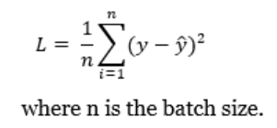
MSE (Mean Square Error)
1) It is used in Regression
2) MSE is the preferred loss function if the distribution of the target variable is Gaussian. Mean squared error is defined as the average of the squared differences between the predicted and actual values.

Slide 25
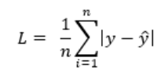
MAE (Mean Absolute Error)
1) It is used in Regression
2) It is defined as the average of the absolute difference between the actual and predicted values

Slide 26
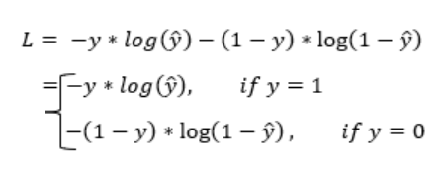
Binary CrossEntropy
1) It is used in Binary Classification
2) It measures the difference between two probability distributions. If the cross entropy is small, it suggests that two distributions are similar to each other.
3) In case of a binary classification the predicted probability is compared to the target/actual (0 or 1). Binary Cross-entropy calculates a score that provides the negative average difference between the actual and predicted probabilities for predicting the class 1. This score penalizes the probability based on the distance from the expected value

Slide 27
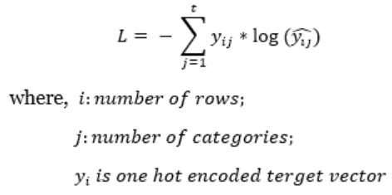
Categorical CrossEntropy
1) It is used in Multiclass Classification
2) In case of a multi-class classification the predicted probability is compared to the target/actual, where each class is assigned a unique integer value (0, 1,2, 3, …, t), assuming data has t unique classes. It calculates a score that provides the negative average difference between the actual and predicted probabilities for all classes.
3) For multi-class cross entropy, actual targets (y) are one-hot encoded. For a 3-class classification [[0,0,1], [1,0,0], [0,1,0]]

Slide 28
Sparse Categorical CrossEntropy
1) It is used in Multiclass Classification
2) Both, multi-class cross entropy and sparse multi-class cross entropy have the same loss function. The only difference is the way true labels(y) is defined. For sparse categorical cross entropy, one needs to provide a single integer unit only rather than an n-dimensional vector.
3) For sparse multi-class cross entropy, actual targets (y) are integers. For above 3-class classification problem: [0], [1], [2]

